Slide 1



22 Immutable Laws of Branding
Brand Management
Shaheer Hashmi: 22L-7989
Noman Shoukat: 22L-7888
Hassan Yousaf: 22L-
Muhammad Hassaan: 22L-7919
Waleed Ahmed: 22L-7970

Slide 2
01.
THE LAW OF CONSISTENCY
02.
THE LAW OF CHANGE
TABLE OF
CONTENT

Slide 3
THE LAW OF CONSISTENCY

Slide 4

INTRODUCTION
Key Point: A brand must maintain consistency in its identity to thrive in the market.
Brands must stand for something to establish a position in the consumer's mind.
Manufacturers often contemplate changes, citing market shifts as a reason.
Essential brand characteristics, once established, should remain unchanged.
Recommendation:
Hang in there and maintain brand identity despite market changes.
Choices: Follow market trends and risk brand destruction or wait for the market to swing back.

Slide 5
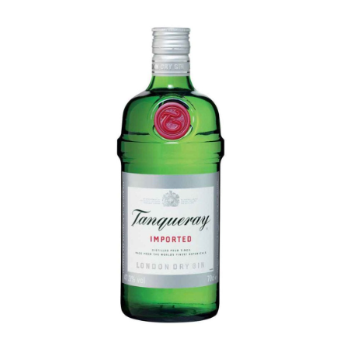
Case Study - Tanqueray's Dilemma
Tanqueray, a leading high-end gin, faces competition from high-end vodka trends set by Absolut and Stolichnaya. Tanqueray introduces Tanqueray vodka to adapt to the market shift.
Analysis:
Tanqueray vodka unlikely to impact Absolut market but may undermine Tanqueray gin.
Suggested Approach: Stick with gin and hope the market swings back in that direction.
Lesson:
Brands are akin to personality statements.
Changing essential brand characteristics risks long-term damage.

Slide 6
The Power of Consistency in Brand Building
Introduction:
Brand building requires consistent messaging over an extended period.
Examples: Volvo's safety and BMW's "ultimate driving machine" maintained for decades.
Pitfalls of Inconsistency:
Volvo's deviation into sports cars diluted the safety message.
BMW's introduction of a station wagon eroded the driving image in consumers' minds.
Lesson Learned:
Consistency builds and reinforces brand identity.
Boredom should not lead to deviation from the established brand message.

Slide 7
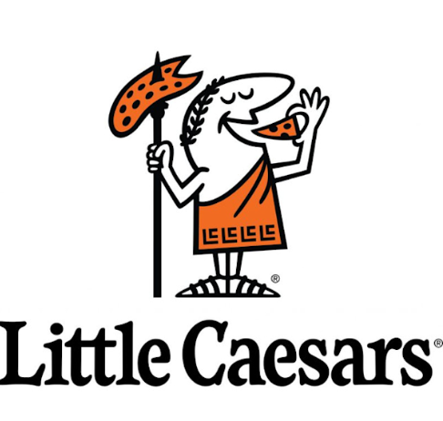
Little Caesars - A Case Study in Brand Erosion
Success Story:
Little Caesars built a strong brand with the "Pizza. Pizza." message.
Became the second-largest pizza chain in America with a focus on takeout.
Mistakes and Consequences:
Diversification into delivery and size changes led to confusion and loss of identity.
Resulted in a drop to third place in sales behind Pizza Hut and Domino's Pizza.
Recovery Efforts:
Some stores reverting to the two-for-one strategy, indicating a realization of the importance of consistency.

Slide 8

The Pitfalls of Unnecessary Diversification
Case Example: McDonald's and the Arch Deluxe:
McDonald's, known for being kid-oriented, attempted to introduce an adult hamburger (Arch Deluxe).
$150 million in advertising but declared a disaster and removed from the menu.
Brand Limitation:
The essence of branding is limiting the brand to stand for something simple and narrow.
McDonald's success lies in being a kid-oriented, family restaurant.
Takeaway:
Brands must resist the temptation to deviate from their core identity.
Limitation, combined with consistency over decades, is essential for successful brand building.

Slide 9
THE LAW OF CHANGE
“brands can be changed, but only infrequently and very carefully”

Slide 10
Introduction
why change?
nothing is absolute, there are exceptions to every rule:
law of change is an exception to the law of consistency
examples of change:
improve quality of product
improve quality of product
launch a new ad campaign
focus on changing the image of the brand in the minds of the consumers
following are situations where change is desired:

Slide 11

1 – Your brand is weak or non-existent in the minds of consumers
brand is non-existent or has lost its value
brand will not face any consequences as a result of rebranding compared to big companies
Example(Intel):
Initially, intel could not provide enough competitive advantage due to which:
Intel declined from an 82.9% market share in 1974 to a paltry 1.3% share in 1984.
The company rebranded itself by replacing D-RAM production with micro processors (intel inside and intel Pentium).

Slide 12

02.
You Want to Move Your Brand Down the Food Chain

Slide 13
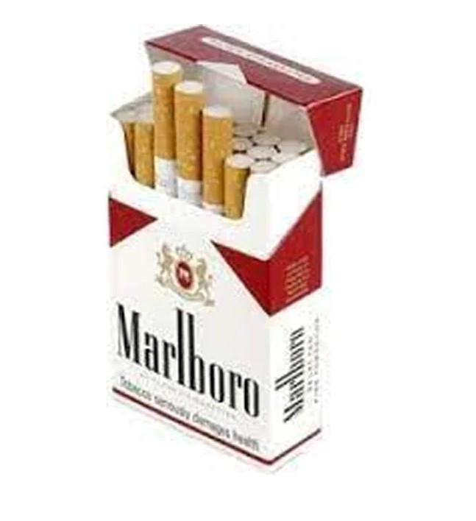
Key Points:
1. A brand must lower its price slowly without hurting itself.
Marlboro lowered its cigarette prices and gained market share.
Sometimes prices get out of line and permanent adjustments need to be made.
Building Rolls-Royces is considered as luxurious but not a lot of profit.
3. Moving a brand to a higher price category is considered more challenging, if not impossible.
Holiday Inn Crowne Plaza, a hotel chain, which faced difficulties until it removed "Holiday Inn" from its name. This implies that the association with the more affordable Holiday Inn brand was hindering its ability to position itself as a more upscale or premium offering.

Slide 14
03.
Your Brand Is in a Slow-Moving Field and the Change Is Going to Take Place Over an Extended Period of Time

Slide 15

Example of Citibank
Twenty-five years ago Citicorp (and its Citibank subsidiary) was 80 percent corporate and 20 percent consumer.
But today the numbers are almost reversed. Citicorp is 30 percent corporate and 70 percent consumer.
Citicorp is successfully moving its Citibank brand from corporate to consumer business.
Instead of “changing” minds, Citicorp has allowed enough time to pass so that the natural process of “forgetting” takes place.
Customers are never wrong.
When you try to tell customers that your brand is different than it used to be, they will reject your message.
e Xerox computers? No, Xerox is a copier.
e IBM copiers? No, IBM is a computer.
e Epson computers? No, Epson is a computer printer.

Slide 16
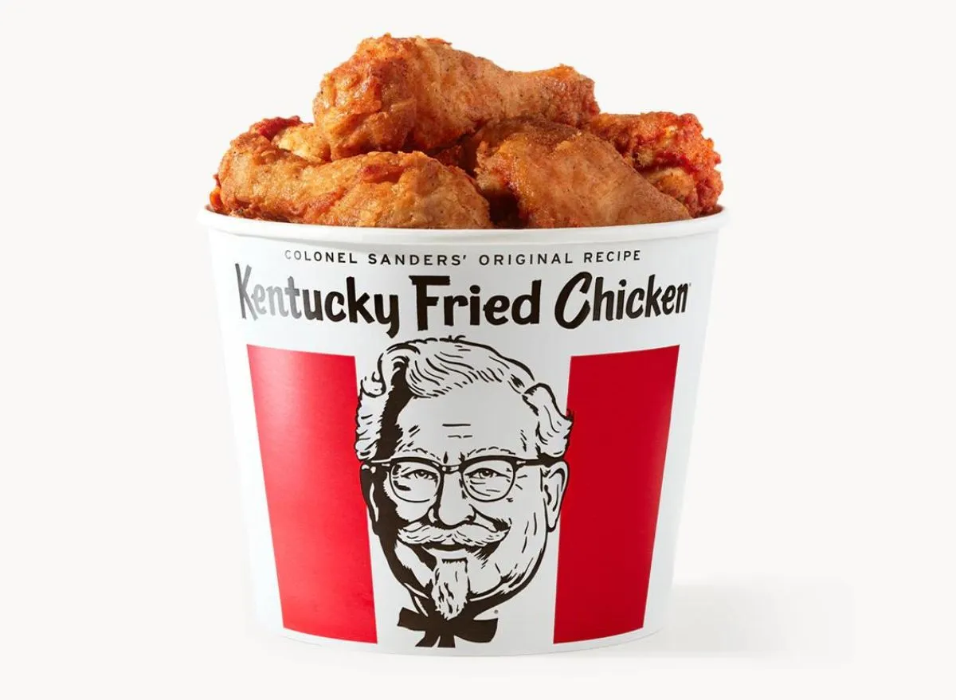
Case Study – Kentucky Fried Chicken to KFC
Kentucky Fried Chicken changed name to KFC in 1991
Reasons:
There are several conspiracies for this change..
According to Kyle Craig, the change was an attempt to distance chain from the unhealthy connotations of “fried”.
KFC promoted rotisserie chicken as healthier alternative to fried chicken.
Consequences:
Brands Rotisserie chicken didn’t gain any reputation.
People still went and ask for fried chicken.

Slide 17
Precautions of Changing Brand
Look into consumers mind if you are not there at all, change away.
If you have unique and distinct perception, then change your brand at your own risk.
It is going to be a long, difficult, expensive, and perhaps impossible process.

Slide 18
Law of Consistency
vs
Law of Change

Slide 19

Consistency vs Change
Law of Consistency is an ultimate and universal law which is always beneficial in long run.
Law of Change is just an exception that may work only when brand is not established.
However, Other school of thoughts says that change is a constant in the business environment and brands must adapt to survive and thrive.

Slide 20
THANK YOU
Have any question?

